Slide 1
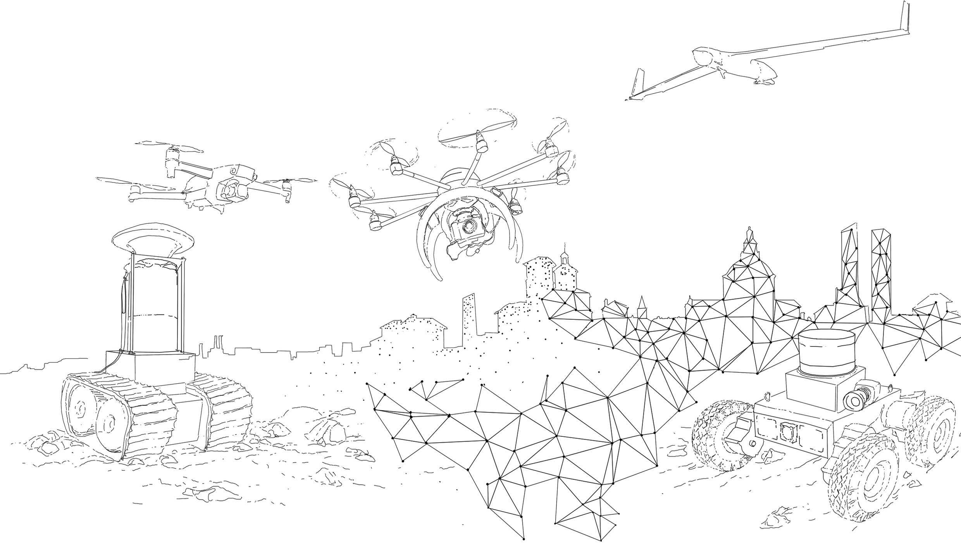
D-SITE 2022
Drones - Systems of Information on culTural hEritage
International Conference meeting
16th-17th-18th June 2022
Title of contribution
Author name
University

